Slide 1
Extract Signatures from Cancer Genomes to Imrpove Classification and Management of Cancers
HCC Exome Sequencing Data Analysis
Integrated Analysis of Multiple Omics Data
Explore More Information from Molecular Data

Slide 2
1. HCC Exome Sequencing Data Analysis

Slide 3
Introduction
// TP53: Probe, mutation sites
Targeted exome sequencing 440 designed genes of advanced HCC patients (recurrent in 2 years) with Sorafenib treatment.
101 patients with PR+CR, SD, PD respectively
We want to detect significant signatures that can predict the drug response and then validate it.

Slide 4
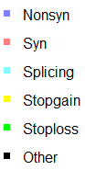
1.1 Mutation Number
log10 scale
//hypermutated patients
Type | ALL | 94 Patients
Nonsyn | 22922 | 689
Syn | 14429 | 352
Stopgain | 1966 | 52
Stoploss | 20 | 0
Splicing | 759 | 26
Other | 1530 | 104
Sum | 42035 | 1227
101
Hypermutated
7
94
PR:2
SD:3
PD:2
Unknown
PR+CR:11
SD:47
PD:28
8
86

Slide 5
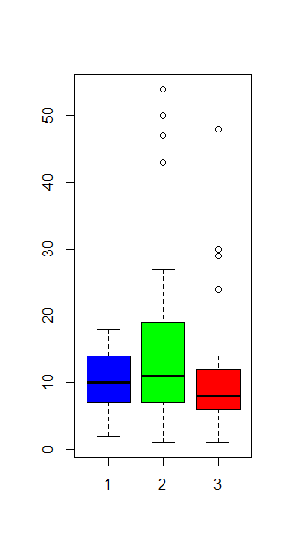

Sig of difference
# Mutations
Type | p.value(aov) | p.value(ks.test)
Nonsyn | 0.378 | 0.711
Syn | 0.807 | 0.591
Sum | 0.588 | 0.366
//No significance
PR+CR
SD
PD
Unknown
# Mutations/Mb
PR+CR
SD
PD
//median=5,mean=6.511

Slide 6
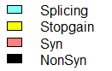
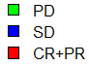
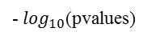
Result Overview
# Mutations/Mb
Splicing
PD
Stopgain
SD
Syn
CR+PR
NonSyn
30
# Mutations
0
0
- $\log_{10}$(pvalues)
4
0
pvalues
0.8

Slide 7
1.2 Detect Signatures - Gene
Significant mutated genes
Association with drug response
Fisher’s exact test
LASSO logistic regression
Decision trees

Slide 8
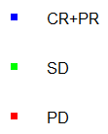
Association with drug response (Nonsyn+Stopgain+Splicing )
1. Fisher’s exact test (For every gene:)
No. of patients
-log10(pvalues)

Slide 9
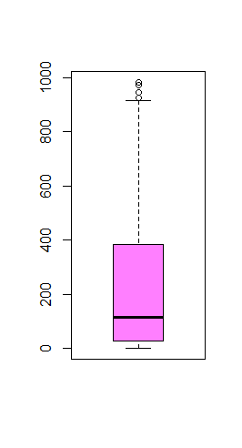
2. Logistic + LASSO
Deal with unbalanced samples: bootstrap equal-size sub-samples (50).
Repeat this 1000 times, and select genes appeared in most iterations (>500).
No.
-log10(pvalues)
// number: (36 #>500)/(199 #appearance)

Slide 10
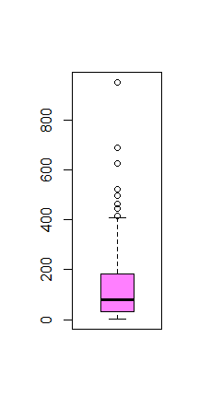
3. Decision trees
No.
-log10(pvalues)
// Tree > 300 & LASSO > 500 & Fisher < 0.3
SIRT6 POU5F1 ARID2 KAT6A MAPK14 ATRX SETD2 ALK USP9X MSH6 NCOA1 MN1 FGFR2 ARRB1

Slide 11
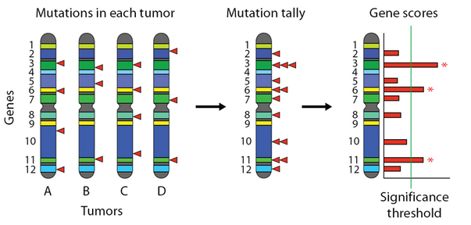
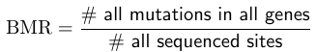
Significantly Mutated Genes (Driver Events)
Key: How to compute background mutation rate (BMR)?
Simple: use the same BMR for all genes
Question: not all genes have the same BMR
* MutSigCV, Lawrence et al., Nature 2013

Slide 12
2. MutSigCV, take into “neighbor” genes (DNA replication time, chromatin state ......) and consider the functional impact of mutations (Lawrence et al., Nature 2013)
-log10(pvalues)

Slide 13
Gene | MutSig | SimpleSig | Fisher | LASSO+Logistic | Tree
TP53 | #INF | 29.83018 | 0.304314 | 534 | 397
BCL3 | 6.578463 | 10.12231 | 0.379915 | 22 | 324
FGFR3 | 4.114166 | 7.045684 | 0.907361 | 12 | 97
ROS1 | 3.79366 | 4.547061 | 0.715099 | 223 | 384
CDH20 | 3.402687 | 6.926731 | 0.126267 | 136 | 197
CRTC1 | 1.353728 | 4.372484 | 0.408134 | 758 | 416
MAPK14 | 0.985175 | 3.130134 | 0.125272 | 921 | 521
PAX3 | 0.846119 | 2.982586 | 0.48336 | 388 | 123
DAXX | 0.453568 | 2.544639 | 0.448639 | 87 | 166
NCOA4 | 0.450982 | 3.393519 | 0.306448 | 38 | 69
TCF3 | 0.450982 | 0.914975 | 0.344961 | 732 | 52
RECQL4 | 0.373311 | 3.145051 | 0.479618 | 131 | 106
PLCG1 | 0.137132 | 1.111834 | 1 | 319 | 41
SETD2 | 0.04839 | 3.492845 | 0.082846 | 588 | 464
STK36 | 0.04839 | 1.614905 | 0.536567 | 148 | 81

Slide 14
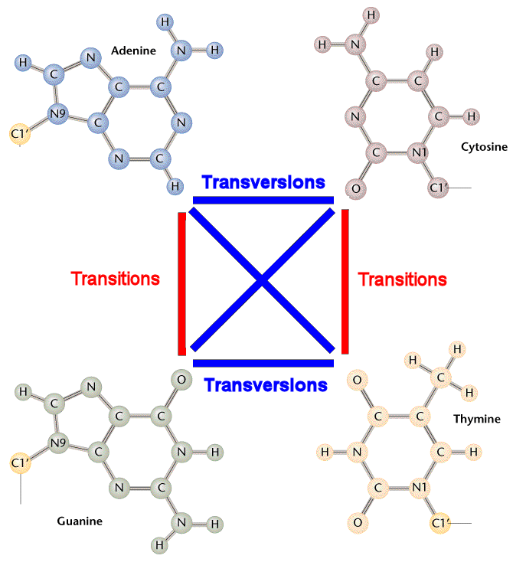
1.3 Substitution
Strong exposure to exogenous mutagens
Endogenous mutagens
...
C>A
C>G
C>T
T>A
T>C
T>G
A
C
G
T
A
C
G
T
__
Other Subtypes
FragSeq (16)
96-substitution classification

Slide 15
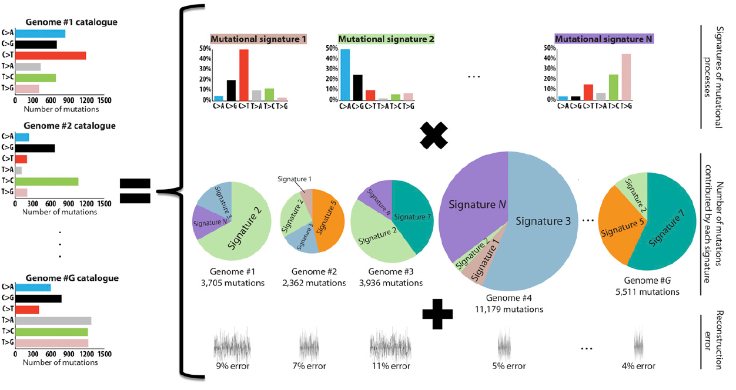
WTSI’s Framework
* Ludmil et al., Cell Report 2013

Slide 16
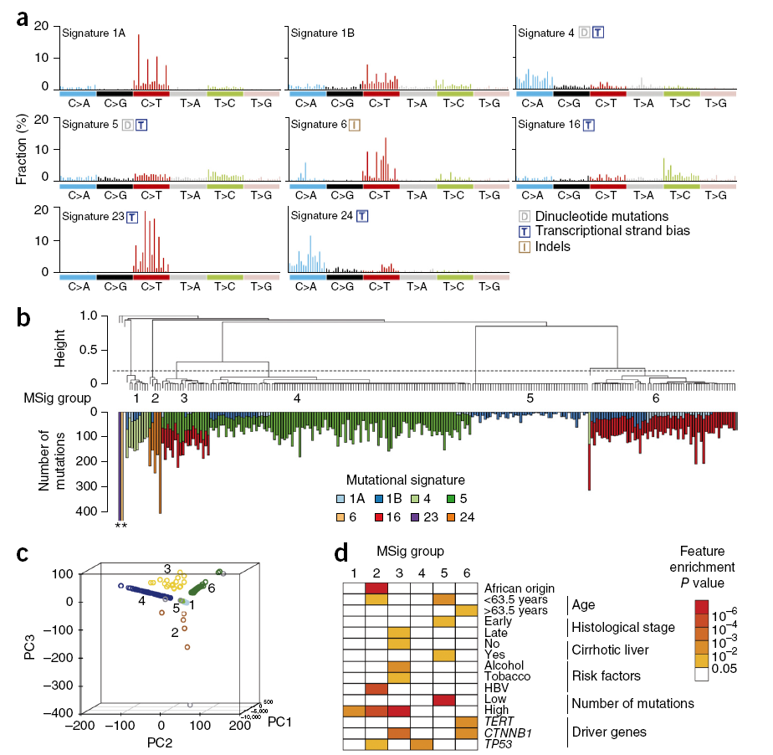
* Schulze et al.,
NG 2015

Slide 17
Result - WTSI
* NG:28478-6184=22,294
* Ours: 1227

Slide 18
1.4 Further Computational Analysis
Pathway and function analysis
Mode of Function: OncodriveROLE
Significance of mutual exclusivity:MEMo
Identify networks:HotNet2, NBS,...
...

Slide 19
2. Integrated Analysis of Multiple Omics Data

Slide 20
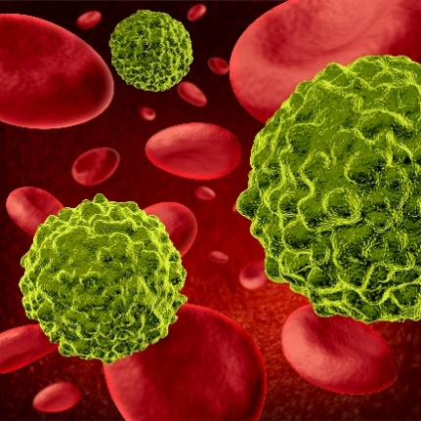

2.0 Cancer Stage
What and Why?
Describe the severity of an individual’s cancer
A common language for doctors to communicate about a patient and help to develop a prognosis and design a treatment.

Slide 21
TNM Staging System by AJCC:
1. T: primary tumor (location,size,extent)
2. N: Lymph node involvement
TX​ | Primary tumor cannot be evaluated​
T0 | No evidence of primary tumor​
Tis​ | Carcinoma in situ
T1–T4​ | Size and/or extent of the primary tumor​
NX | Regional lymph nodes cannot be evaluated​
N0 | No regional lymph node involvement
N1-N3​ | Involvement of regional lymph nodes (number and/or extent of spread)

Slide 22
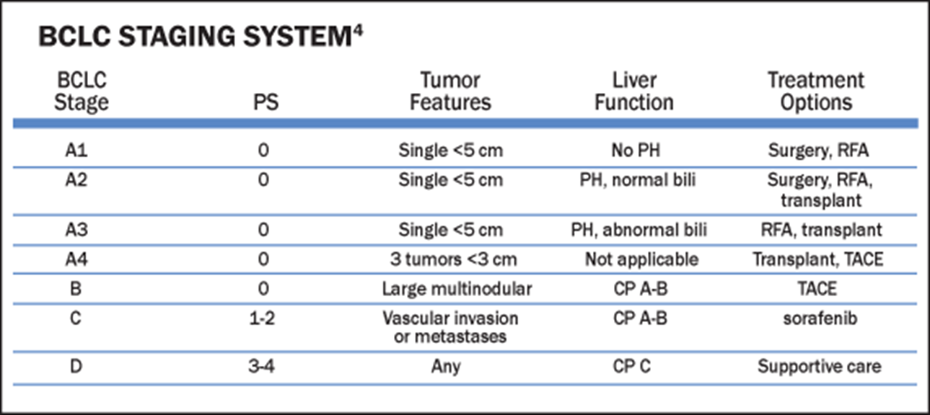
3. M: presence or absence of distant metastasis
M0 | No distant metastasis
M1 | Distant metastasis
https://cancerstaging.org/Pages/default.aspx
https://www.nexavar-us.com/scripts/pages/en/health-care-provider/hcc

Slide 23
p.value=5.26E-06
(168,83,57,11)
p.value=0.0232 (158,77,60)
// TCGA HCC Datasets

Slide 24
Study Molecular classification
Serve as a valuable adjunct to histopathology to help better diagnosis and prognosis. (new mechanism)
Detect new target agents of drug reponse
Explore current therapies to more patients
// Drug repurposing
* Perez et al., Cancer Cell 2015

Slide 25
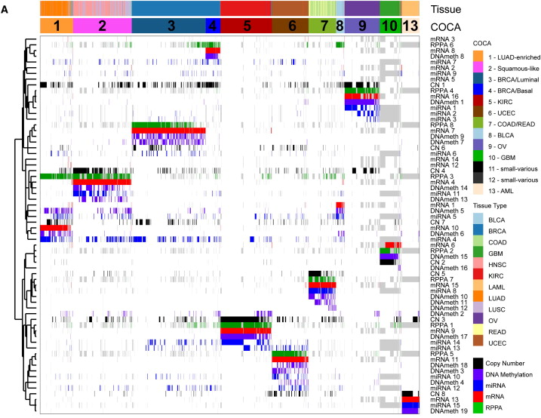
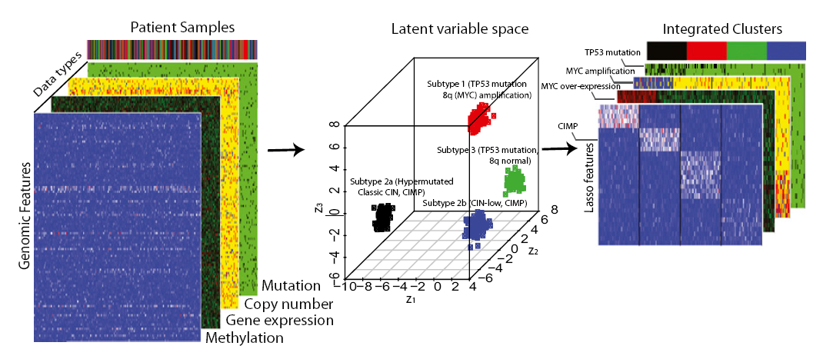
2.1 Methods
How to combine multiple omics data?
Combined then clustered
Cluster of Cluster (COC)
Mo et al, PNAS 2012
Hoadley et al, Cell 2014

Slide 26
We should be cautious and careful in the selection of omics data and the corresponding methods.
ER+
ER-
unknown
// TCGA BRCA Dataset

Slide 27
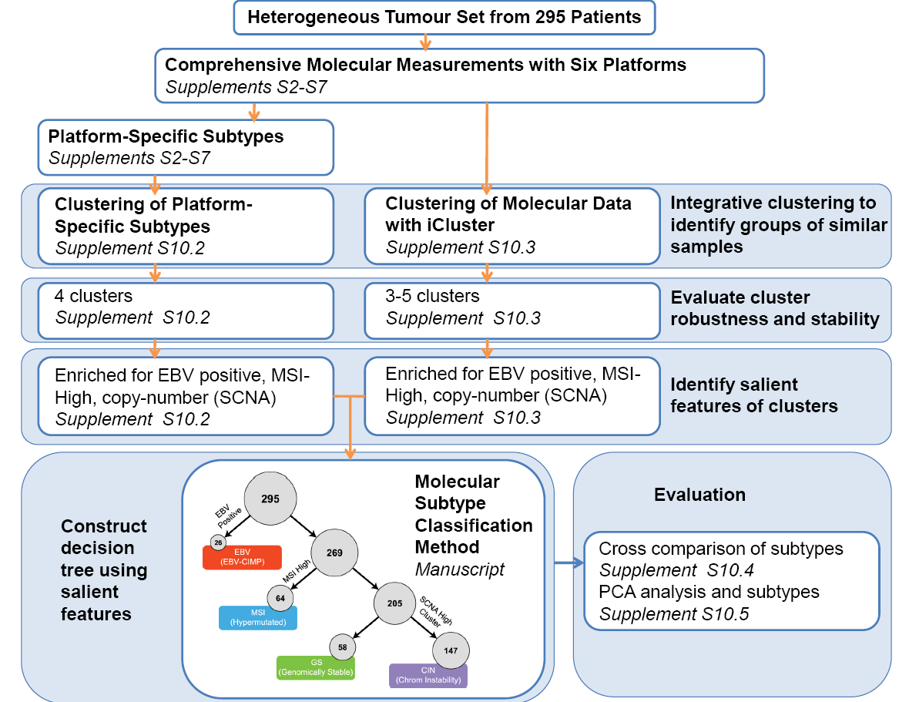
2.2 TCGA Research
Gastric Cancer, Nature 2014
(1).somatic copy number (2).whole-exome sequencing,
(3).DNA methylation profiling,
(4).messengerRNAsequencing,
(5).microRNA (miRNA) seq
(6).reverse-phase protein array (RPPA)

Slide 28
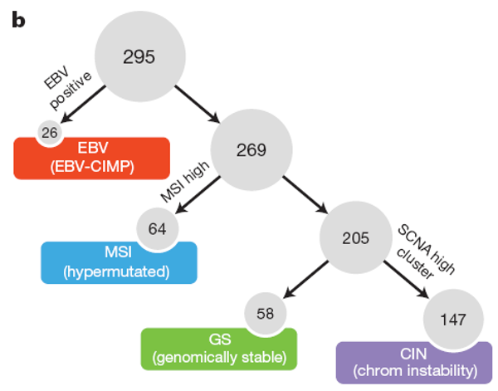
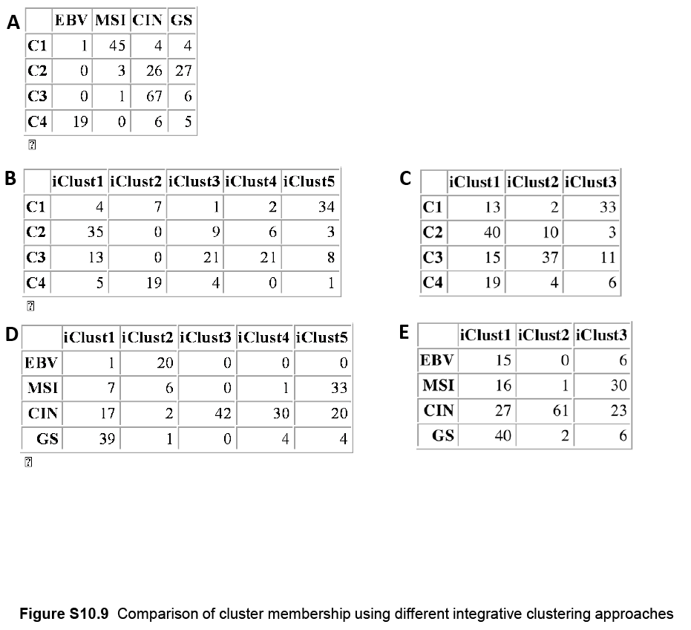
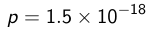

Slide 29
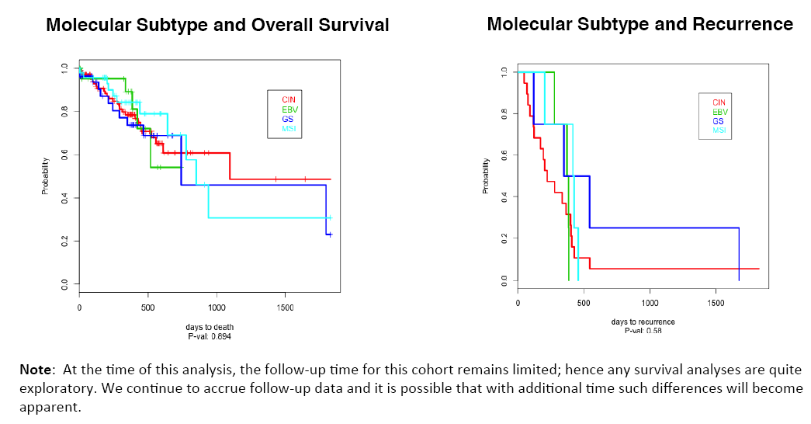

Slide 30
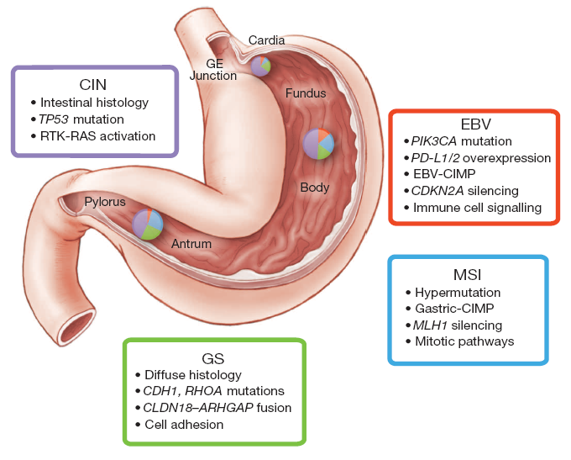
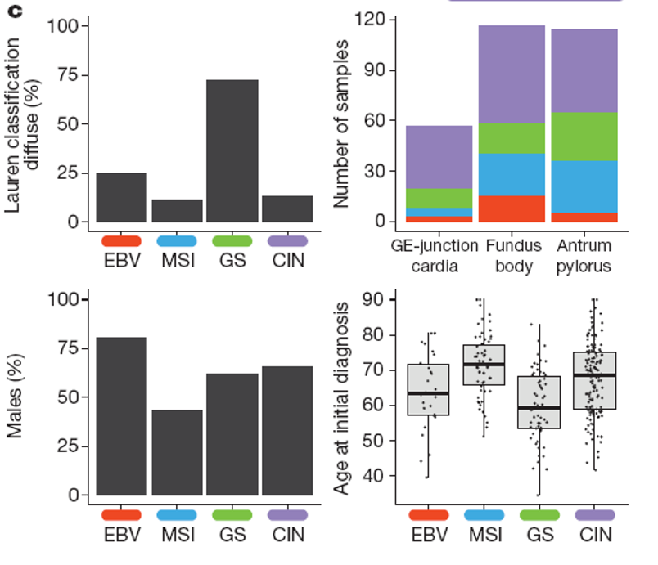

Slide 31
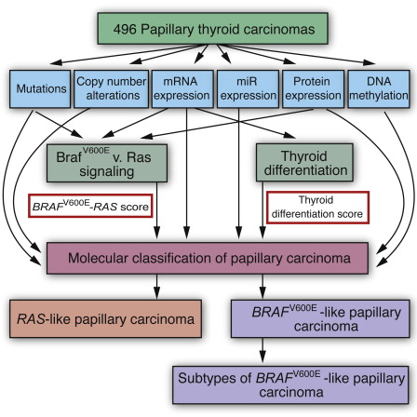
Papillary Thyroid Carcinoma, Cell 2014
//mutation+expression:
meta-cluster
//molecular subtypes

Slide 32
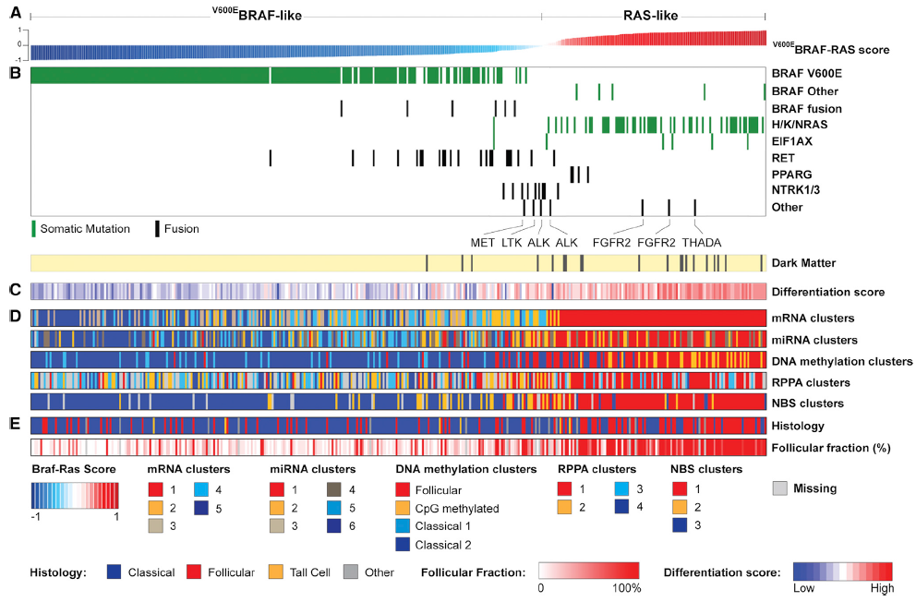
Ras-Like-PTCs and BRAF^{V600E}-Like-PTCs are fundamentally different in their genomic, epigenomic and proteomic profiles. (known histological differences)
Refined classification (reunite RL-PTCs with follicular carcinomias)

Slide 33
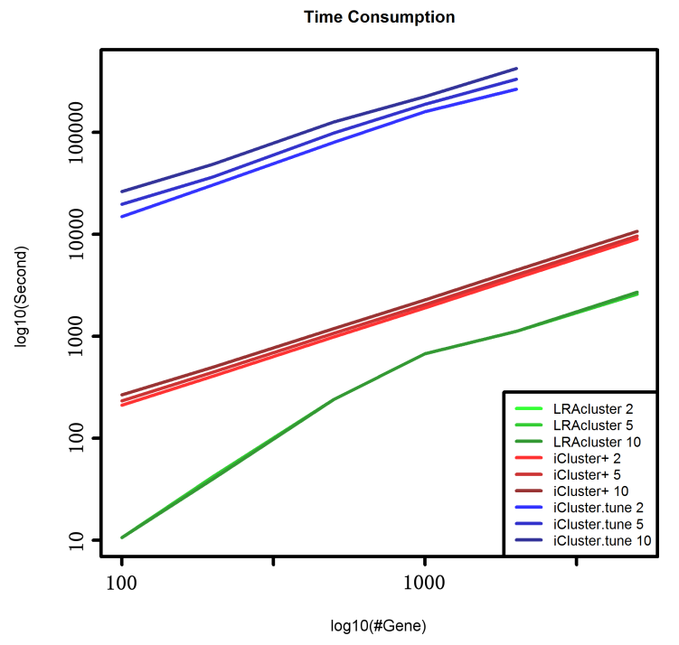
2.3 LRAcluster Overview

Slide 34
2.4 TCGA HCC Data Analysis
Clinical information vs. Survival Analysis (346)
 | Survival Analysis(p.v) | Samples in Each Types
gender | 0.206 | 105,217
neoplasm histologic grade | 0.49 | 44,154,108,12
family cancer history | 0.0513 | 177,103
new tumor event | 0.136 | 166,135
vasular invasion | 0.0442 | 14,88,187
Hepatitis B | 0.000182 | NO=202,YES=98
Alcohol consumption | 0.702 | NO=203,YES=97
pathological stage | 0.0232 | 158,77,60
Pathologic T | 5.26E-06 | 168,83,57,11
Pathologic N | 0.0611 | N0=222，N1=3，NX=96
Pathologic M | 0.00022 | M0=233，M1=3，MX=86

Slide 36
Clinical vs. Molecular (1)
To which extent clinical subtypes have some corresponse with molecular subtypes?
//pathologic stage
COC
CNV
GeneExpre
miRNA
//Vasular invasion

Slide 37
 | COC | GE | CNV | miRNA
gender | 0.22216699 | 0.59504899 | 0.500251736 | 0.94330464
neoplasm histologic grade | 0.03762931 | 0.535232384 | 0.027986007 | 0.31334333
family cancer history | 0.00414964 | 0.385807096 | 0.00149925 | 0.97301349
new tumor event | 0.68582553 | 0.807096452 | 0.357321339 | 0.2053973
vasular invasion | 0.02021166 | 0.56121939 | 0.004497751 | 0.37681159
Hepatitis B | 0.01172148 | 0.794602699 | 0.016491754 | 0.10644678
Alcohol consumption | 0.24469894 | 0.460769615 | 0.101449275 | 0.07646177
pathological stage | 0.09907631 | 0.861569215 | 0.116941529 | 0.98550725
Pathologic T | 0.60474834 | 0.313343328 | 0.566216892 | 0.97251374
Pathologic N | 0.22127901 | 0.763552158 | 0.540931427 | 0.31119166
Pathologic M | 0.7404977 | 0.780147655 | 0.50125814 | 0.6365567
//p.values between clinical classifications and molecular classifications

Slide 38
Clinical vs. Molecular (2)
Use molecular subtypes to make survival analysis
 | Survival analysis
COCcluster2 | 0.203
CNV_3 | 0.0484
GeneExpre_4 | 0.77
miRNA_3 | 0.278
COC
GeneExpre
CNV
miRNA

Slide 39
Clinical + Molecular
How to combine clinical and molecular information?
Cluster of Cluster -> (make clinical classification as a new feature)
Use molecular information to make further classification based on clinical subtypes
Use clinical data as a supervised information to extract signature from molecular information
.......

Slide 40
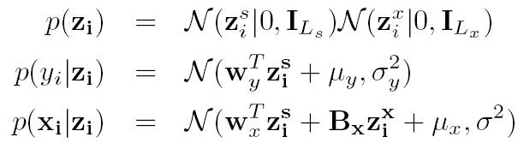
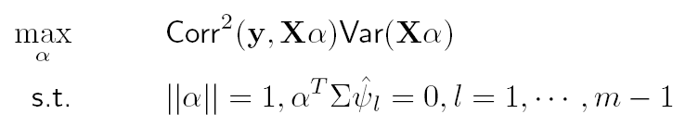
Partial Least Squares
Probabilistic Model:
Statistical Model:

Slide 41
Preliminary Results
 | Survival analysis
GE_pls_2 | 0.405
GE_coc_2 | 0.255
miRNA_pls_2 | 0.11
miRNA_coc_2 | 0.255
CNV_pls_3 | 0.85
CNV_coc_3 | 0.00156
COCwithClinical_2 | 0.21
//Clinical data: pathologic stage; vascular invasion;...

Slide 42
Possible Computational Improvement
More computationally efficiently
Nuclear norm-regularized optimization (ADMM)
SVD-update methods
PLS for integrated analysis and Low-rank approximation formular
It’s easy to use Generalized Linear Model to model multiple omics data.
Low-rank approximation formular

Slide 43
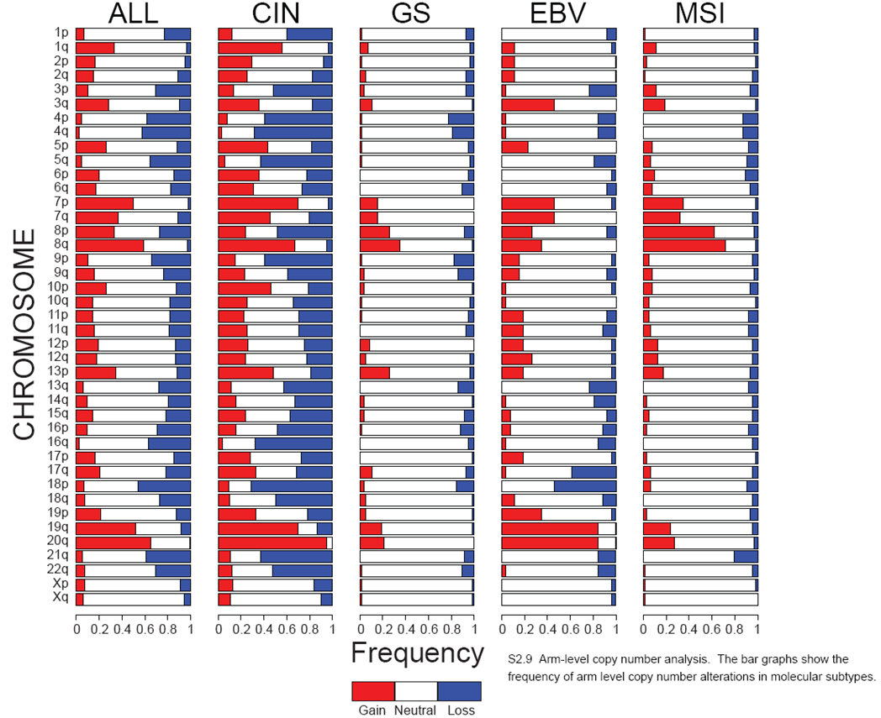
2.5 Future Work
Computational considerations:
It is not appropriate to combine all molecular data in a simple way.
Data types and cancer types shoule be concerned.
//e.g. arm-level CNV features

Slide 44
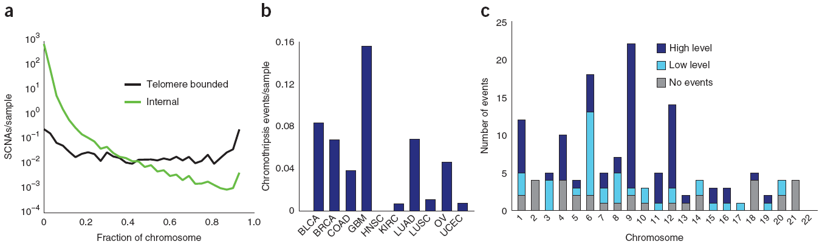
Other considerations:
1. It is not appropriate to make the survival analysis as the evalution criterion. But others?
(1). New classification?
(2). Significant genomic feature?
(3). Drug response?
(4). ......
2. Detect more signatures to find new mechanism.
* Zack eg al, ng, 2013

Slide 45
3. Explore More Information from Molecular Data

Slide 46
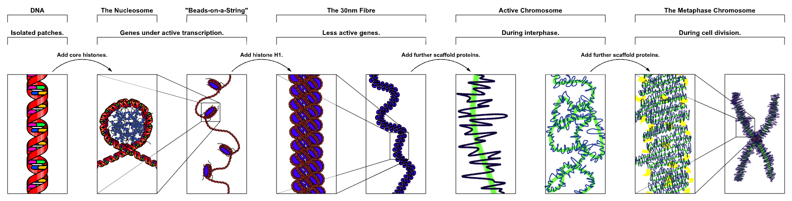
Different Levels of Data
In what scale of genome, we can
make better association between
clinical information and molecular data
make best tumor stratification
Clinical Infomation
Gene
Probe
Neucleotide Site

Slide 47
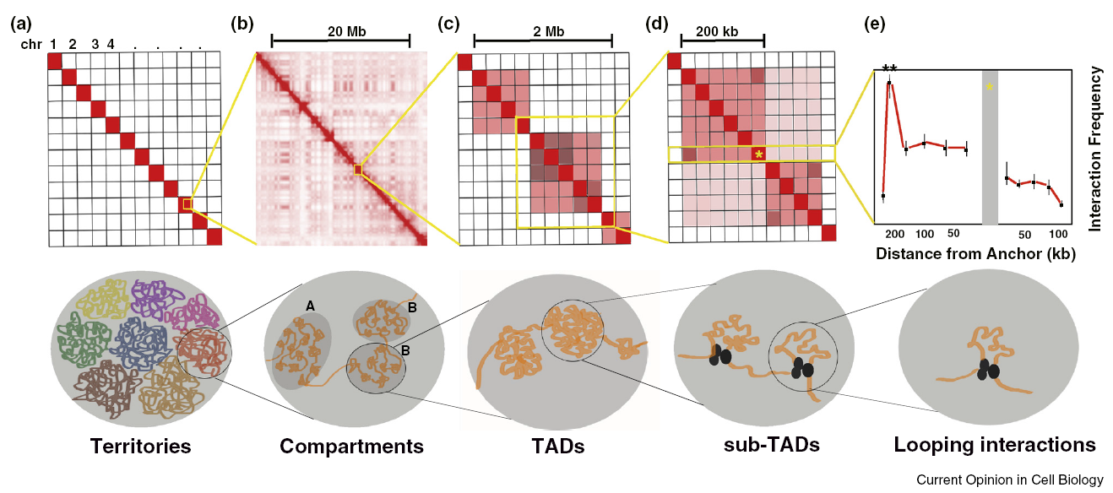
3.1 Chromatin Architecture
* Phillips-Cremins JE,Curr Opin in Cell Biol,2014

Slide 48
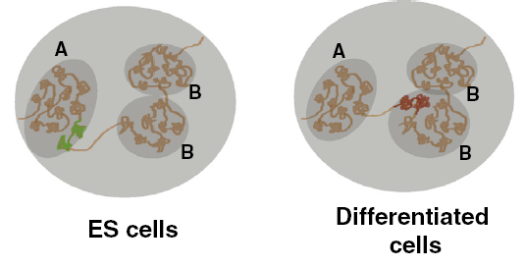
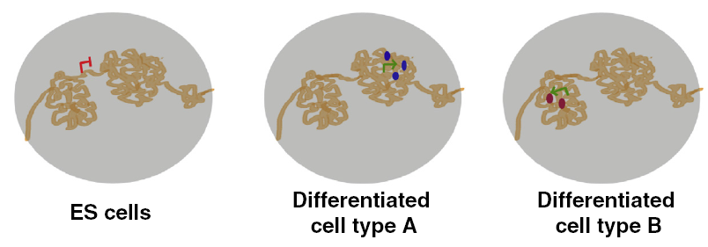
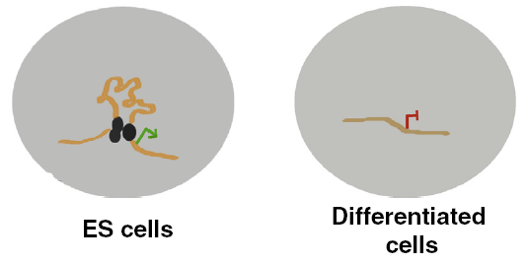
Structure Linked to Function
Architecture has vastly different dynamics and functional outcomes at each level in the hierarchy in response to different developmental signals.
A(open)/B(closed) chromatin | (1).Different proportions between ES and differentied cells (2).‘A’:co-location of different segments of genome in the same transcription factory.
TAD (Invariant) (Mb scale) | (1).Not very clear. (2).May delimit pre-established regulatory landscapes.
Sub-TAD (Markedly reorganized) (sub-MB scale) | Loopings are required for gene activition

Slide 49
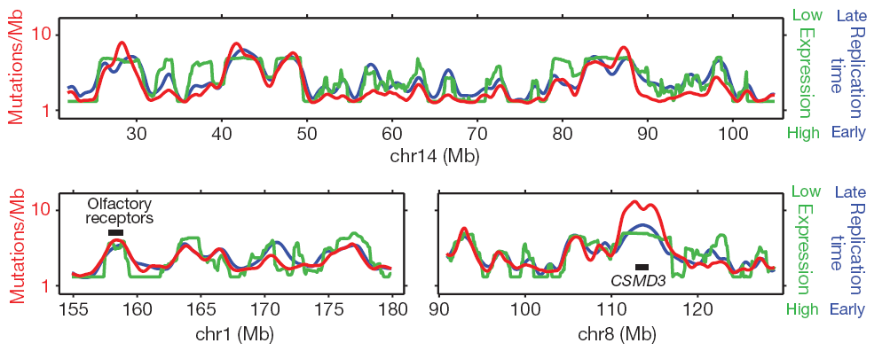
3.2 Related Use of architectures(1)
Detect similar genes in the sense of transcription
MutSigCV uses chromation state(open/close) to find “neighbor” genes to model background rate.
* Lawrence et al., Nature 2013

Slide 50
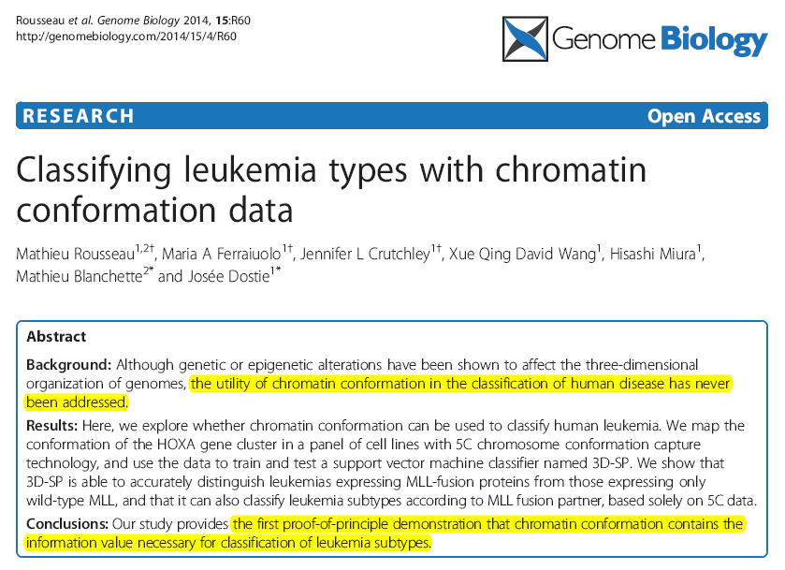
Related Use of architectures(2)
Classifying cancers

Slide 51
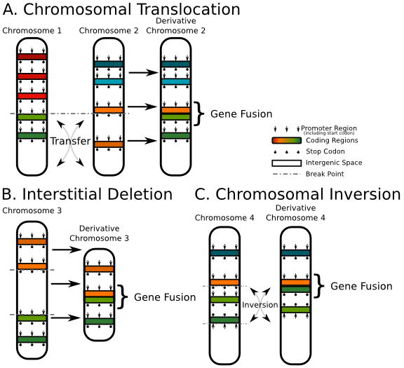
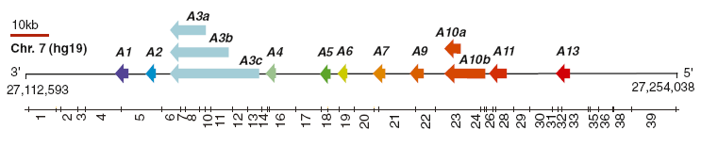
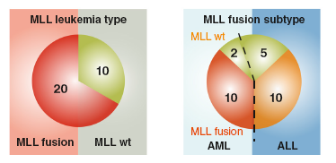
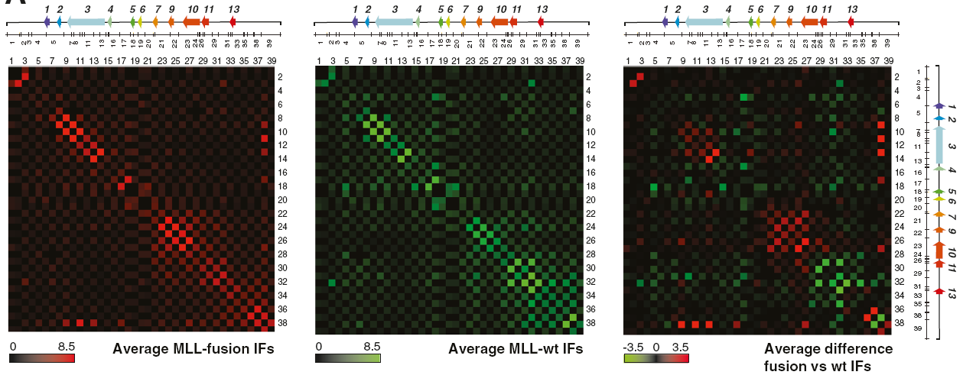
GoF
HOXA cluster (dysregulation)
11 IFs:hematopoietic lineage regulation
MLL gene fusion (from wiki)
Either AML or ALL?
AF9
ENL
wt
//Use HOXA HiC data to classify MLL fusion types

Slide 52
